Slide 1
Predicting the choice of referential expressions in mandarin conversation

Slide 2
AGENDA
What are referential expressions?
What are subjects?
Why Chinese?
What are coreference chains?

Slide 3
The project
Collaboration between Natalia Levshina (MPI Psycholinguistics), Mira Ariel (Tel Aviv University), Liina Lindstrom (University of Tartu), and Prof Du Bois and me
Overall themes:
Communicative efficiency (Levshina’s main research area): How do we make grammatical choices based on how efficient we are communicating?
Accessibility theory (from Ariel): We choose referential forms in a way that conveys how easy it is to think of the referent (we’ll clarify this later_)

Slide 4
What are referential expressions (指稱表達)?

Slide 5
Referntial expressions
Expressions that point to something, e.g.:
They
The girl
A nice computer
The development of jazz
…

Slide 6
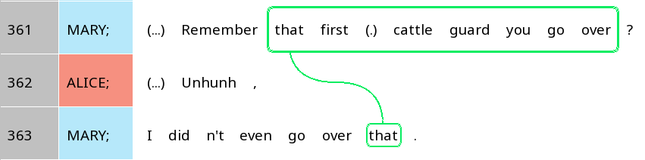
Examining coreference chains
Why are two different referential expressions used for the same entity?

Slide 7
Central claim of accessibility theory
?
High accessibility, i.e. something is easier to think of
Shorter, simpler referential expressions
?
Low accessibility, i.e. something is harder to think of
Longer, more complicated referential expressions

Slide 8
Shorter distance from previous mention
Shorter referential expression
Higher accessibility
Larger number of previous mentions
Less specific referential expression
…
Any more you can think of?

Slide 9
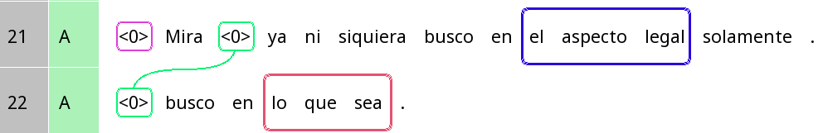


pronoun absence in Spanish
The verb busco implies that the person who is looking is ‘I’
Buscas – ‘you’
Busca – a third person
=> -o acts as a referential expression
Look (I) am not even looking just in the legal aspect.
(I) am looking in whatever.

Slide 10
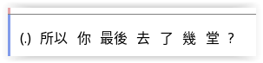
What are arguments (論元)?
Each verb (動詞) has one or more arguments
These are the participants that ‘participate’ in the event denoted by the verb
去 ‘go’ requires a person who goes, and a place that the person goes to
Arguments: 你, 幾堂

Slide 11
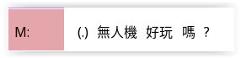
What are Subjects?
If a verb only has one argument, then that argument is the subject
無人機 is the only argument, and hence the subject
[Note: What we usually call 形容詞 in Chinese act as verbs]
These verbs are called intransitive verbs (自動詞) and their subjects are abbreviated S

Slide 12
What are Subjects?
If a verb has two arguments, then the argument that is more like the ‘doer’ is the subject
你 is more like the doer than 幾堂, so it is the subject
These verbs are called transitive verbs (他動詞) and their subjects are abbreviated A

Slide 13
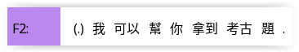
Quick test!
Identify all the arguments and subjects.

Slide 14
Quick test!
Verbs: 幫, 拿到
For 幫:
Arguments are 我 and 你
我 is the subject since it is the argument that is more ‘doer’-like
For 拿到:
Arguments are 我 (implicitly) and 考古題
The implicit 我 is the subject

Slide 15
Subjects in Spanish
In Spanish, and many other languages, the form of the verb tells you about the subject, but not other things (like the object)
Look (I) am not even looking just in the legal aspect.
(I) am looking in whatever.

Slide 16
Why Chinese?

Slide 17
Subjects in our project
The focus of our research is subjects (though we will still consider non-subjects when considering the context)
This is because languages differ as to:
Whether referential expressions separate from the verb are necessary
English: In many cases, they are necessary
Spanish and Chinese: They are usually not necessary
Whether subjects are expressed by verbal inflection
English: Mostly no, except very marginally (am / is / are etc.)
Chinese: Not at all
Spanish: Mostly yes

Slide 18
So what will we do?

Slide 19
TIMELINE of major goals (optimistic)
Fall, week 5
Fall, week 10
Winter, week 5
Winter, Week 10
Spring, week 2
Complete annotation of verbs, referential expressions, and subjects
Complete annotation of predicate properties
Complete ½ of the annotation of referential expression properties
Complete all annotations
Convert Rezonator annotations into data tables in R using rezonateR

Slide 20
Weekly goals
Every time we start on a task, we start with a pilot set of annotations, say ~50 lines
On the second week, we discuss any difficulties you faced when working with those lines
In doing so, we refine our instructions for annotations
In the next four weeks, we extend the project to ~250 lines total
We will continue the process on the second week until we’ve finished everything
At present, we are not doing inter-annotator agreement for this project (we might later, we’ll see), but informal peer checking is still highly recommended whenever you face uncertainty

Slide 21
What are subjects (主語)?

Slide 22
Step 1 (this week): Identify all predicates
In general, ‘predicates’ means verbs
This is similar to the notion of 謂詞 in Chinese (note: not the same as 謂語)
Some verbs may not look like them but you still need to count them: e.g. 我要睡, 要 and 睡 are both verbs!
Remember that in Chinese ‘adjectives’ are also considered verbs
Special exception of things to be included in the predicate, other than the verb itself:
With the verb 是, the phrase after 是 is also included in the predicate, e.g. 他是老師 – 是老師 is the predicate
The aspect markers 了 and 過 (see document), e.g. 他吃了飯 – 吃了 is the verb

Slide 23

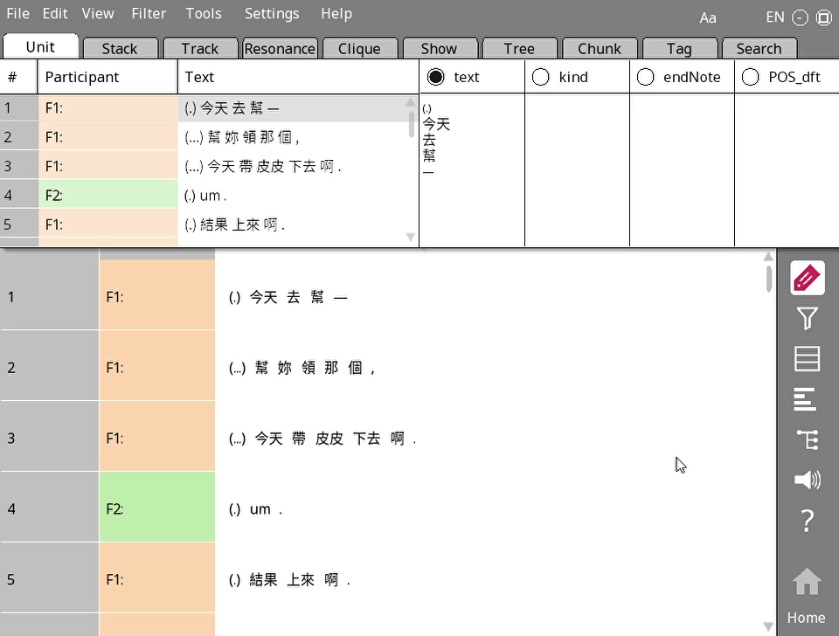
Step 1 (this week): Identify all predicates – Rezonator instructions
Switch to tag mode in the first button of your side bar
Drag and drop (not click) on the verb
(Sorry I didn’t show this in the video, but actually 去 and 下去 are also verbs)

Slide 24
Step 2 (this week): Identify referential expressions
Usually, this is the same as ‘noun phrases’
Generally speaking, they are arguments, but they may also be e.g.:
Part of a predicate: 他是奧巴馬
Free-standing: A: 天上有飛機 B: 飛機?
Topics, e.g. 香港樓價很貴, 今天沒課要上
Also include referential expressions that are unfinished (中華人-)
‘Zero’ arguments should also be marked

Slide 25
Marking up referential expressions in Rezonator
Trail
Track
Track

Slide 26


Linguistic terminology vs. Rezonator terminology
Linguistic terminology | Rezonator terminology
Intonation unit (in this class) | Unit
(Word) token | Token
Coreference chain | Trail
Mention, referential expression | Track

Slide 27
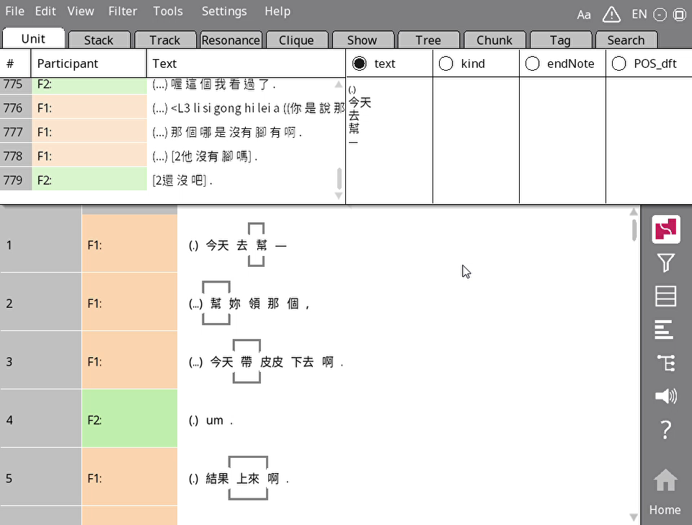

Step 2 (this week): Identify referential expressions – Rezonator instructions
Switch to track mode in the first button of your side bar
To add a single-token (word) referential expression, just click on it
To add a multi-token expression, drag and drop like you did for verbs
To switch to a new trail, click on whitespace or hit ESC on your keyboard

Slide 28
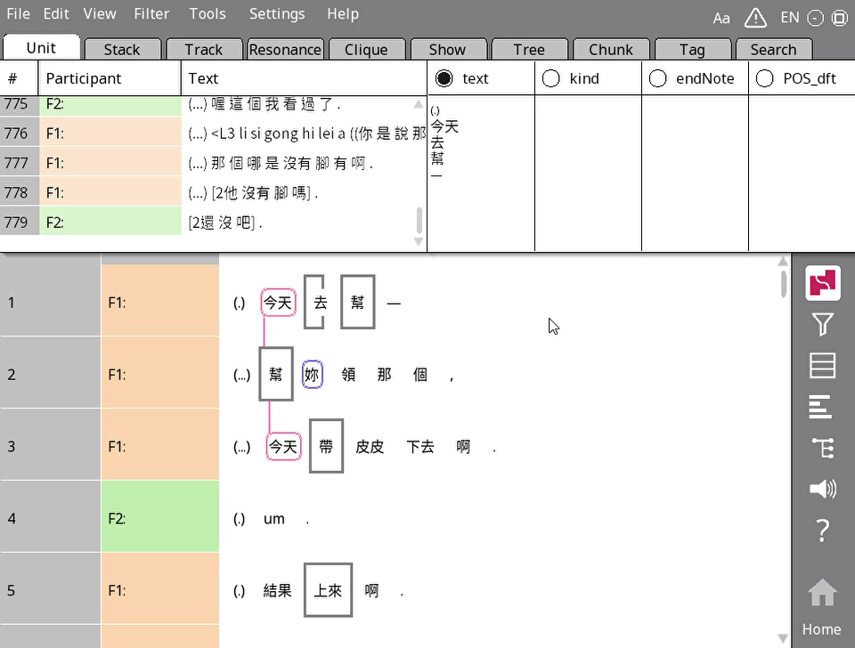
Step 2 (this week): Identify referential expressions – Rezonator instructions
5. To add a zero, mouse over the word BEFORE the zero and hit the Z button on your keyboard. Put the zero in the place that you think would be the most natural (that usually means before the verb).
Put a zero there even if it wouldn’t actually make sense to have a non-zero expression, e.g. 我要睡 > 我要<0>睡

Slide 29
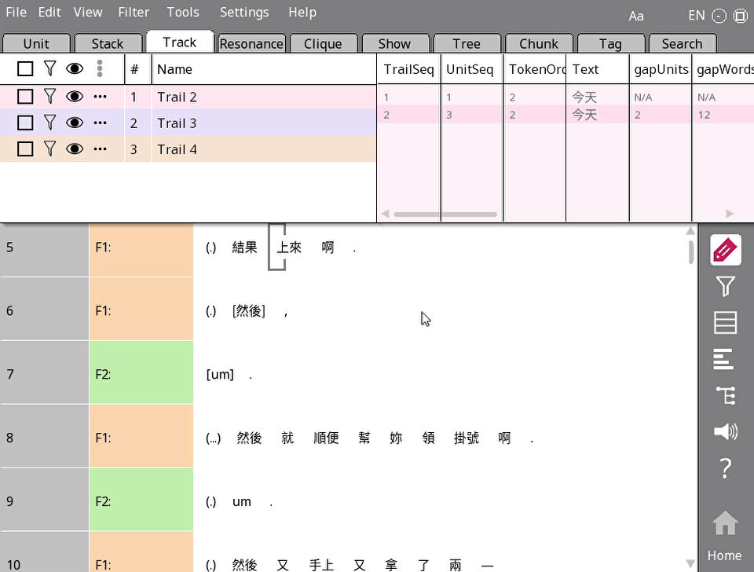
Step 2 (this week): Identify referential expressions – Renaming trails
After creating chains, go to the Track tab. Rename the trails by right-clicking on each trail and then change their names.

Slide 30
Step 3 (this week): Identify subjects
Mark subjects of transitive verbs as A
Mark subjects of intransitive verbs as S
Although it sounds strange, 是 will count as an intransitive verb

Slide 31

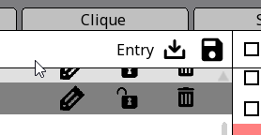
Step 3 (this week): Identify subjects – Part 1
We first need to load the annotation scheme.
Go to the Tag tab.
Look in the top right of the top left window. Change Token to Entry (see pic).
Click on the load button and load tag_step1.json from GitHub.

Slide 32
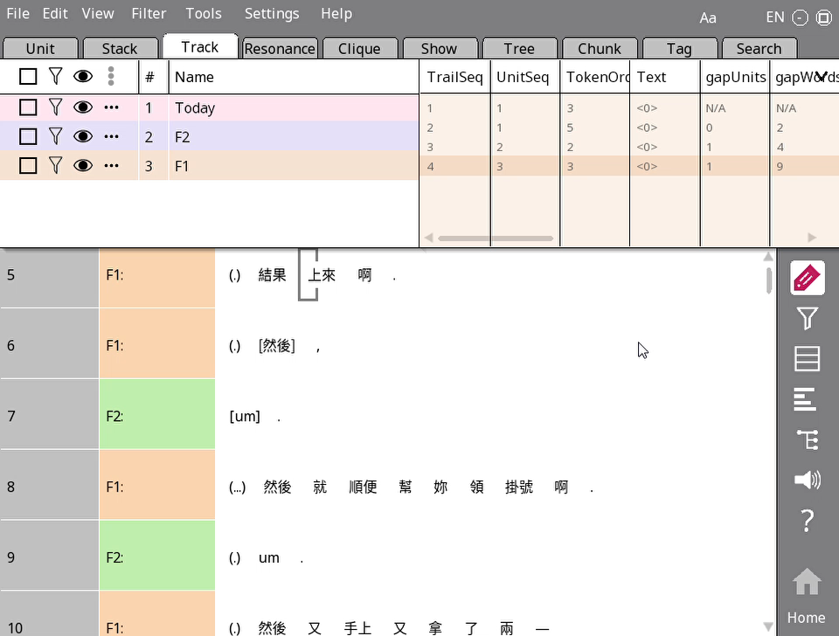
Step 3 (this week): Identify subjects – Part 2
Go to the Track tab and click gapWords or gapUnits
Change field > Select field > Gramrole
You have now displayed a new field on the screen. We will be doing this step all the time.

Slide 33
Step 3 (this week): Identify subjects – Part 3
Use the drop-down menu or type to mark referential expressions as S or A.
If they are not subjects, you don’t have to do anything.

Slide 34
Where to find the files
The .rez files you will work on are in the folder 11_final_rez.
You should use the Save as feature to save a new copy of the file with your annotations, in the 13_trails_rez folder.
Once you are done, commit and push the change to GitHub, and move the issue assigned to you to Done on plane.

Slide 35
THANK YOU

